Slide 1

Congruence
Geometry for Teachers
Von Christopher G. Chua, LPT, MST
Instructor, Geometry for Teachers

Slide 2
Chapter Objectives
For this chapter in the course on Statistical Methods, graduate students are expected to develop the following learning competencies:
Explain the concept of congruence and correspondence.
Develop appreciation for precision on the use of language and symbols relevant to the concept of congruence of triangles.
Discuss the dificulties and challenges encountered by teachers in developing in students the competencies related to triangle congruence.
Suggest plans for activities that may be used by teachers in class.
This slideshow presentation will be made available through the class’s official website, mathbychua.weebly.com. The site will also provide access to download this file in printable format.

Slide 3
The Idea of Congruence
Reviewing the concept of geometric congruence

Slide 4
Congruence
Two geometric figures are congruent if they have exactly the same shape and size.
If there is a correspondence between the vertices of two triangles in such a way that all corresponding sides and all corresponding angles are congruent then the triangles are congruent.

Slide 5
Activating Teacher’s Knowledge
In groups of three, develop a plan composed of a specific series of activities that a teacher can use in class to develop students’ understanding of congruence.
Describe each activity by stating its objective, explaining the process and roles to be undertaken by both student and teacher, time frame, and, whenever applicable, one or a couple of sample items.
Discuss the output with the rest of the class.

Slide 6
Activating Teacher’s Knowledge
Guide for Class Discussion
Does the plan provide students the opportunity to construct their knowledge, independent from the teacher?
Do the activities provide appropriate feedback?
Do the suggested activities form a cohesive whole, related to each other but in increasing level of difficulty?
Does the sequence of activities adhere with the phases of learning based on Van Hiele’s model of geometric thought?
Which minimum level in the Van Hiele’s model will the plan work?
Did the group specify how the plan can be modified to work for students who are below the targeted level?

Slide 7
Geometric Transformations
Knowing how to start…
Translation
“moving along a line without rotatting or resizing”
Every point of the shape must move the same distance in the same direction.
Rotation
“turning around the center”
Reflection
“a flip over a line (of reflection)”
Every corresponding pair of points in the shape and its reflection is the same distance to the line of reflection.
How will doing an activity focusing on geometric transformations help in building students’ understanding of congruence?

Slide 8
Are the two figures of the same shape and size? Explain your answer.

Slide 9
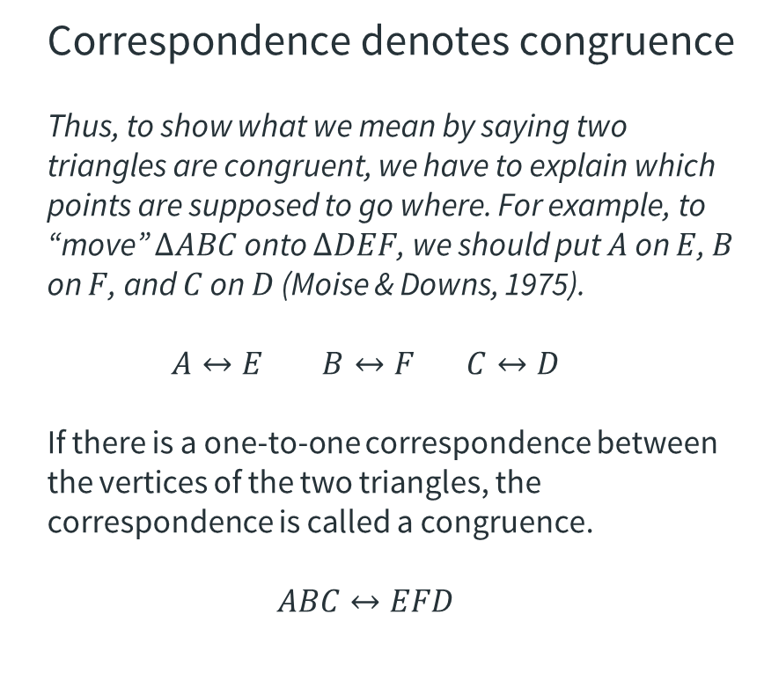
Correspondence as congruence
Formalizing understanding
Correspondence denotes congruence
Thus, to show what we mean by saying two triangles are congruent, we have to explain which points are supposed to go where. For example, to “move” $∆ABC$ onto $∆DEF$, we should put $A$ on $E$, $B$ on $F$, and $C$ on $D$ (Moise & Downs, 1975).
$$A↔E B↔F C↔D$$
If there is a one-to-one correspondence between the vertices of the two triangles, the correspondence is called a congruence.
$$ABC↔EFD$$
D
E
F
C
A
B

Slide 10
Congruence between Triangles
Understanding concepts, postulates, and theorems related to triangle congruence

Slide 11
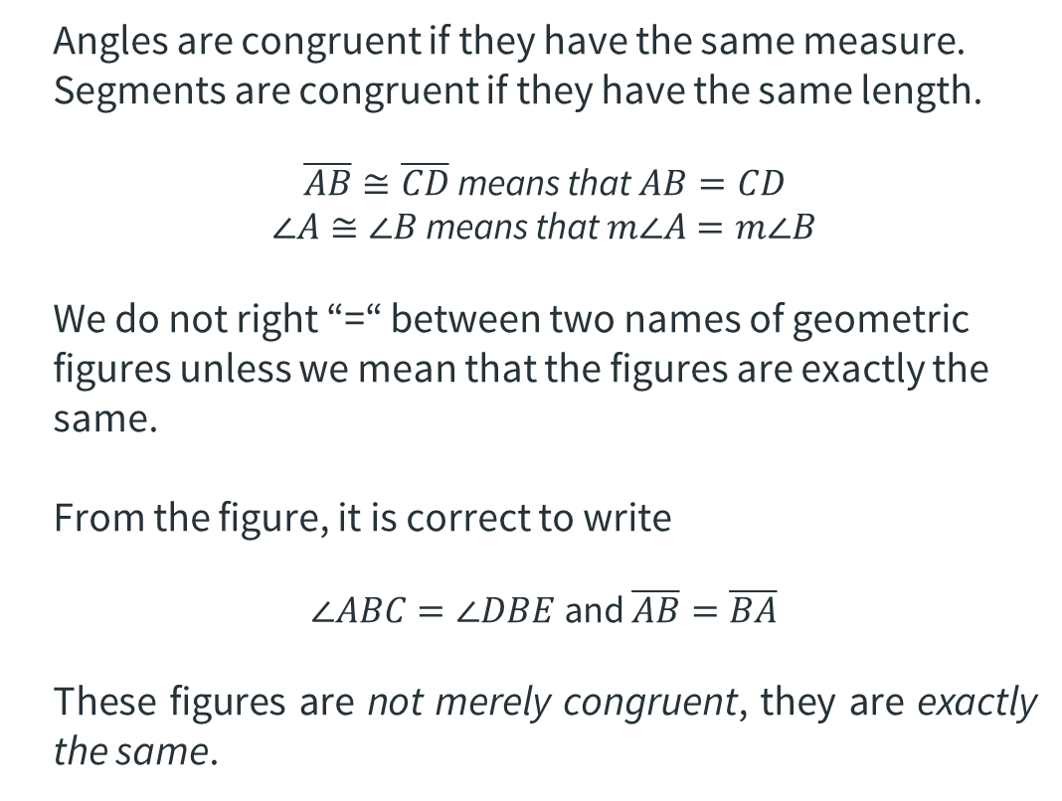
Congruent angles and segments
Precision in language and symbols
Angles are congruent if they have the same measure. Segments are congruent if they have the same length.
$\overline{AB}≅\overline{CD}$ means that $AB=CD$
$∠A≅∠B$ means that $m∠A=m∠B$
We do not right “=“ between two names of geometric figures unless we mean that the figures are exactly the same.
From the figure, it is correct to write
$∠ABC=∠DBE$ and $\overline{AB}=\overline{BA}$
These figures are not merely congruent, they are exactly the same.
.
.
A
D
.
.
.
B
E
C

Slide 12
Congruence as equivalence relation
Stating properties
Theorem 5-1
Congruence for segments is an equivalence relation.
Theorem 5-2
Congruence for triangles is an equivalence relation.
Note: A relation that is reflexive, symmetric, and transitive is called an equivalence relation.

Slide 13
Congruence Postulates and Theorems for Triangles
SSS Postulate
SAS Postulate
ASA Postulate
SAA Theorem
HL Theorem

Slide 14
Learning from experience
Reflect on the following
What difficulties did you have as a student when you first encountered congruence postulates for triangles?
Describe the cause of these difficulties.
How will you address these difficulties as a teacher?
What activity can you suggest that will allow students to discover and deepen their knowledge of congruence postulates for triangles?

Slide 15
Thinking Up Your Own Proofs
Developing logical proofs to support theorems

Slide 16
Review on Logic and Reasoning
A proposition is a set of words and symbols that collectively make a claim that can be classified as true or false.
Decide whether the following are propositions or not:
23 = z
10 – 7 = 3
5 < 27
All women are mammals.
Where do you live?
A propositional variable is a variable that represents a proposition usually denoted by P, Q, R, …

Slide 17
Review on Logic and Reasoning
Given two propositional variables, P and Q, these two variables may be combined to form a new one. These are combined using the logical operators or connectives: “and”, “or”, or “not”.
The proposition “P implies Q” is called an implication and is also called a conditional statement.
A conditional proposition has a converse, an inverse, a contrapositive, and a biconditional proposition.

Slide 18
Review on Logic and Reasoning
Reasoning is a process based on experience and principle that allow one to arrive at a conclusion. Reasoning has the following types: (a) intuition; (b) Induction; and (c) deduction.
Deduction is the type of reasoning in which knowledge and acceptance of selected assumptions guarantee the truth of a particular conclusion.

Slide 19
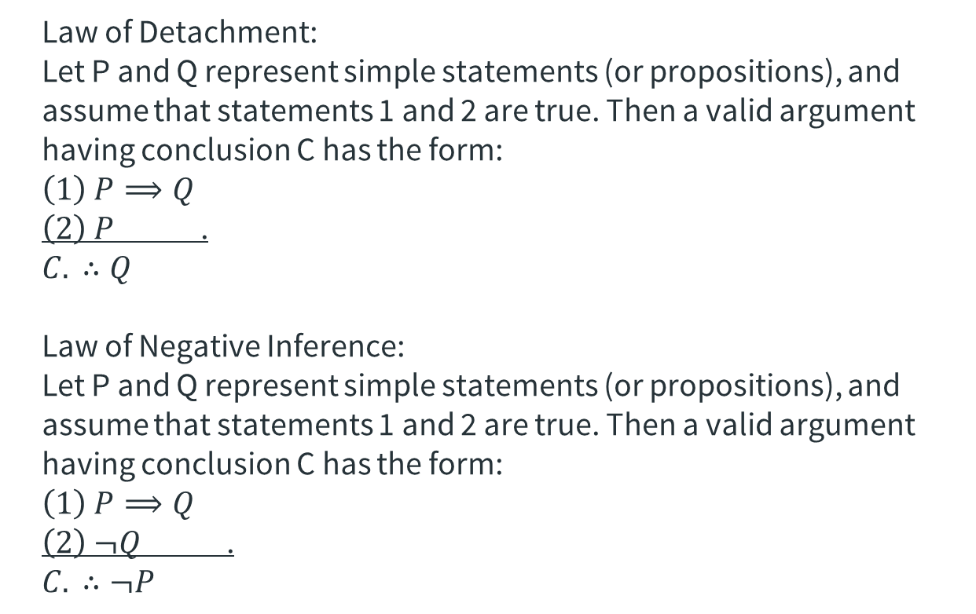
Review on Logic and Reasoning
Law of Detachment:
Let P and Q represent simple statements (or propositions), and assume that statements 1 and 2 are true. Then a valid argument having conclusion C has the form:
$$\left(1\right) P⟹Q$$
$\left(2\right) P$ .
$$C. ∴Q$$
Law of Negative Inference:
Let P and Q represent simple statements (or propositions), and assume that statements 1 and 2 are true. Then a valid argument having conclusion C has the form:
$$\left(1\right) P⟹Q$$
$\left(2\right) ¬Q$ .
$$C. ∴¬P$$

Slide 20
Constructing Two-Column Proofs
Theorems should be proved using the following step-by-step procedure.
From the statement, identify the hypothesis(es) and the conclusion.
On one side, make a marked diagram based on the statement.
State the hypothesis(es) as “Given” and the conclusion as the statement to “Prove”.
Make a two-column table. On the left, present statements in successively numbered steps. The last statement must be the one to be proved. All the statements must refer to parts of the diagram.
On the right, next to the statements, provide a reason for each statement. Acceptable reasons in the proof of a theorem are given facts, definitions, postulates, and previously proven theorems.

Slide 21


Examples
Given the figure with $∠SRK≅∠K$, $∠VRT≅∠T$, $KR=TR$, and $∠M≅∠N$, prove that $SK=VT$. What part of the hypothesis is not useful?
Given: $∠SRK≅∠K$, $∠VRT≅∠T$, $KR=TR$, $∠M≅∠N$
Prove: $SK=VT$
M
S
K
R
STATEMENT | REASON
1. $∠SRK≅∠K$, 2. $∠VRT≅∠T$, 3. $KR=TR$ 4. $∠M≅∠N$ | Given
5. $∠SRK≅∠VRT$ | Vertical Angle Theorem, (Fig)
6. $∠K≅∠VRT$ | Transitive Property (T 4-2), 1, 5
7. $∠K≅∠T$ | Transitive Property (T 4-2), 2, 6
8. $\overline{KR}≅\overline{TR}$ | Definition of Congruent Segments, 3
9. $∆SRK≅∆VRT$ | ASA Postulate, 5, 7, 8
10. $\overline{SK}≅\overline{VT}$ | CPCTC, 9
11. $SK=VT$ | Definition of Congruent Segments, 10
T
V
N

Slide 22

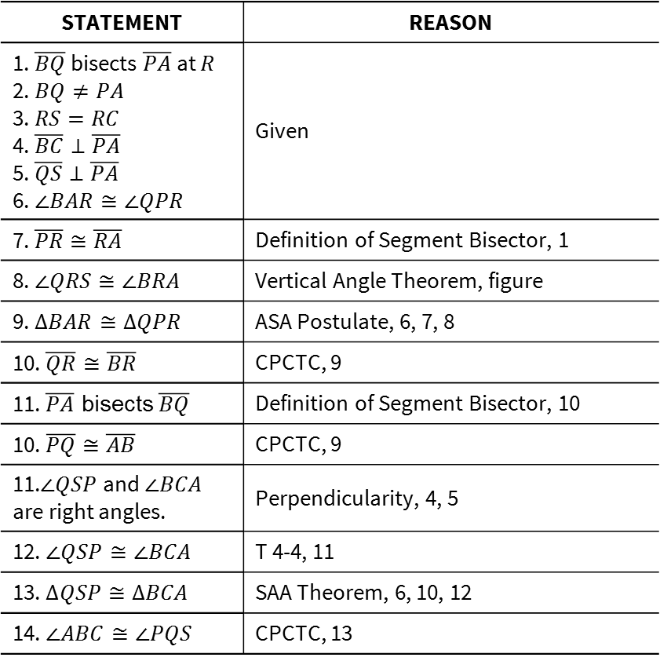
Examples
STATEMENT | REASON
1. $\overline{BQ}$ bisects $\overline{PA}$ at $R$ 2. $BQ≠PA$ 3. $RS=RC$ 4. $\overline{BC}⊥\overline{PA}$ 5. $\overline{QS}⊥\overline{PA}$ 6. $∠BAR≅∠QPR$ | Given
7. $\overline{PR}≅\overline{RA}$ | Definition of Segment Bisector, 1
8. $∠QRS≅∠BRA$ | Vertical Angle Theorem, figure
9. $∆BAR≅∆QPR$ | ASA Postulate, 6, 7, 8
10. $\overline{QR}≅\overline{BR}$ | CPCTC, 9
11. $\overline{PA}$ bisects $\overline{BQ}$ | Definition of Segment Bisector, 10
10. $\overline{PQ}≅\overline{AB}$ | CPCTC, 9
11.$∠QSP$ and $∠BCA$ are right angles. | Perpendicularity, 4, 5
12. $∠QSP≅∠BCA$ | T 4-4, 11
13. $∆QSP≅∆BCA$ | SAA Theorem, 6, 10, 12
14. $∠ABC≅∠PQS$ | CPCTC, 13
Given that $\overline{BQ}$ bisects $\overline{PA}$ at $R$, but $BQ≠PA$. $B$ and $Q$ are on opposite sides of $\overset{⃡}{PA}$. $S$ and $C$ are points on $\overline{PR}$ and $\overline{AR}$, respectively, such that $RS=RC$, $\overline{BC}⊥\overline{PA}$, and $\overline{QS}⊥\overline{PA}$. Also, $∠BAR≅∠QPR$. Prove that $\overline{PA}$ bisects $\overline{BQ}$ and that $∠ABC≅∠PQS$.
B
P
S
R
C
A
Q

Slide 23
Students’ Difficulties with Proofs
Understanding the complexities and challenges that comes with developing skills in geometric proving.

Slide 24
What is a “proof”?
A mathematical proof is a formal and logical line of reasoning that begins with a set of axioms and moves through logical steps to a conclusion (Griffiths, 2000, p.2)
There is importance in distinguishing formal proofs asked of students and the proofs constructed by mathematicians. Routine calculations and logical manipulations are suppressed to make formal proofs simpler (Thurston, 1994)
A proof is…
An argument that convinces an enemy (Mason, et. al., 1982)
An argument that convinces a mathematician who knows the subject (Davis & Hersh, 1981)
An argument that suffices to convince a reasonable skeptic (Volmink, 1990)
Notes:
The purpose is to establish a theorem’s mathematical certainty.

Slide 25
What is a “proof”?
A proof’s purpose is to…
Explain: so one can understand WHY a statement is true.
Systematize: to organize previously disparate results into a unified whole.
Communicate: a means to discuss and debate ideas
Discover: to develop new theories from previously established ones.
Justify a definition: to show that a definition adequately captures the intuitive essence of the concept and that its properties can be derived from the definition.
Develop intuition: to develop a conceptual and intuitive understanding of the concept that one is studying.
Provide autonomy: to train students to independently construct and validate new mathematical knowledge.
Notes:
The purpose is to establish a theorem’s mathematical certainty.

Slide 26
The challenge in geometric proofs
Students find the process of proving difficult because…
Explain: so one can understand WHY a statement is true.
Systematize: to organize previously disparate results into a unified whole.
Communicate: a means to discuss and debate ideas
Discover: to develop new theories from previously established ones.
Justify a definition: to show that a definition adequately captures the intuitive essence of the concept and that its properties can be derived from the definition.
Develop intuition: to develop a conceptual and intuitive understanding of the concept that one is studying.
Provide autonomy: to train students to independently construct and validate new mathematical knowledge.
Notes:
The purpose is to establish a theorem’s mathematical certainty.

Slide 27
A time limit of two hours will be given to take the test.
Only one task will be given under pedagogy taking into account your understanding of how the van Hiele’s model of Geometric thought works in the teaching of Geometry.
Sixty percent of your score will be taken from the first component while forty percent will be based on your response to the task in the second component. A rubric will be provided as guide.
Under content are ten questions that will assess your understanding of Euclidean Geometry focusing on the following chapters: (1) Sets, Real Numbers, and Lines; (2) Lines, Planes, and Separation; (3) Angles and Triangles; (4) Congruence; (5) Proofs; and (6) Geometric Inequalities.
The test will have two components: (a) Content; and (b) Pedagogy.
Preparing for the Midterm Exam
Pointers for acing the middle of the term test

