Slide 1
Precalculus: CONIC SECTIONS: CIRCLES
Von Christopher G. Chua

Slide 2
Let’s look back…
What are the different conic sections? Describe how each are formed as intersections of a double right circular cone and a plane.
What is a circle?
What is the equation of a circle whose center is at the origin?
What is the standard form of the equation of a circle?
Notes:
5 mins

Slide 3
STANDARD FORM of the equation of a circle
The standard form of the equation of a circle whose center is at the origin with radius, r, is
$$x^{2}+y^{2}=r^{2}$$
For any circle whose center have coordinates (h, k) with radius, r, the standard form of its equation is
$${\left(x−h\right)}^{2}+{\left(y−k\right)}^{2}=r^{2}$$

Slide 4
Session Objectives
For this two-hour period, SHS students in Precalculus are expected to develop the following learning competencies:
illustrate the different types of conic sections
define a circle;
determine the standard form and general form of the equation of a circle; and
graph a circle in a rectangular coordinate system.
This slideshow presentation will be made available through the class’s official website, mathbychua.weebly.com. The site will also provide access to download this file in printable format.
Notes:
10 min

Slide 5
LOCATING POINTS
Consider the circle represented by the equation
Points may be divided into three categories depending on its position with reference to the circle.
$${\left(x−2\right)}^{2}+{\left(y−3\right)}^{2}=13$$

Slide 6
IN, ON, or OUT
Consider the circle with equation,
$${\left(x+2\right)}^{2}+{\left(y−4\right)}^{2}=100$$
Determine the location of the following points relative to the circle.
P (-2, 14)
Q (-6, 6)
R (-10, 9)
S (7, 9)
Notes:
10 min

Slide 7
Complete me…
The points given below are on the circle with equation
$${\left(x−7\right)}^{2}+{\left(y+1\right)}^{2}=121$$
Find the missing coordinate for each point.
A $(0, y)$
B $(−10, y)$
C $(x, −5)$
D $(x, −\frac{5}{8})$
Notes:
10 min

Slide 8
GENERAL FORM of the equation of a circle
The general form of the equation of a circle is
${Ax}^{2}+{Ay}^{2}+Cx+Dy+E=0$
where $A≠0$

Slide 9
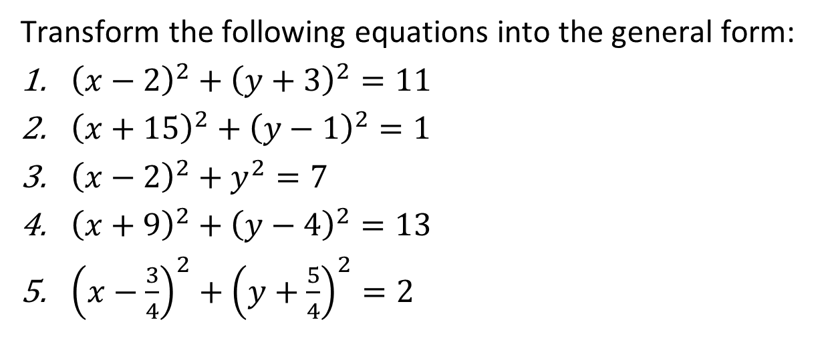
GENERAL FORM of the equation of a circle
Transform the following equations into the general form:
${\left(x−2\right)}^{2}+{\left(y+3\right)}^{2}=11$
${\left(x+15\right)}^{2}+{\left(y−1\right)}^{2}=1$
${\left(x−2\right)}^{2}+y^{2}=7$
${\left(x+9\right)}^{2}+{\left(y−4\right)}^{2}=13$
${\left(x−\frac{3}{4}\right)}^{2}+{\left(y+\frac{5}{4}\right)}^{2}=2$

Slide 10
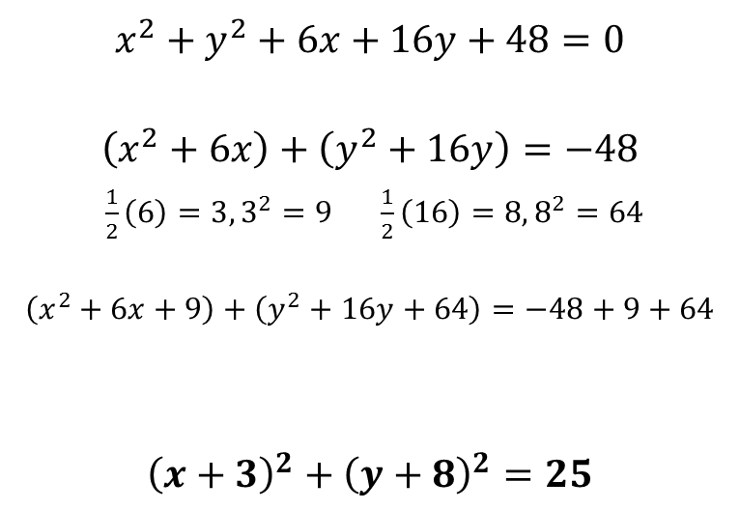
Transforming equations
$$x^{2}+y^{2}+6x+16y+48=0$$
$$\left(x^{2}+6x\right)+\left(y^{2}+16y\right)=−48$$
$\frac{1}{2}\left(6\right)=3, 3^{2}=9 \frac{1}{2}\left(16\right)=8, 8^{2}=64$
$$\left(x^{2}+6x+9\right)+\left(y^{2}+16y+64\right)=−48+9+64$$
$${\left(x+3\right)}^{2}+{\left(y+8\right)}^{2}=25$$
Group the terms based on the variables.
Complete the square to make each group of terms a perfect square trinomial (PST). Add the constants of the PSTs to the right side.
Express the PSTs as squares of binomials
Notes:
https://www.khanacademy.org/math/algebra2/intro-to-conics-alg2/expanded-equation-circle-alg2/e/equation_of_a_circle_2

Slide 11
Transforming equations
Transform the following equations into the standard form:
$x^{2}+y^{2}−6x−7=0$
$x^{2}+y^{2}−14x+2y=−14$
$16x^{2}+16y^{2}+96x−40y−315=0$

Slide 12
Graphing Circles
Graph the following circles:
$${\left(x−3\right)}^{2}+{\left(y+5\right)}^{2}=16$$
$${\left(x+1\right)}^{2}+y^{2}=36$$
$$x^{2}+y^{2}+10x+12y=−12$$
$$9x^{2}+9y^{2}+42x+84y+65=0$$
Notes:
Graphs to Equations:
Start with activity sheets, page 25 of Teaching Guide for SHS: Precalculus
Equations (Standard Form) to Graphs:
https://www.khanacademy.org/math/algebra2/intro-to-conics-alg2/standard-equation-circle-alg2/e/graphing_circles

Slide 13
Problems Involving Circles
A ferris wheel is elevated 1 m above ground. When a car reaches the highest point on the ferris wheel, its altitude from ground level is 31 m. How faraway from the center, horizontally, is the car when it is at an altitude of 25 m?
Notes:
Graphs to Equations:
Start with activity sheets, page 25 of Teaching Guide for SHS: Precalculus
Equations (Standard Form) to Graphs:
https://www.khanacademy.org/math/algebra2/intro-to-conics-alg2/standard-equation-circle-alg2/e/graphing_circles

Slide 14
Problems Involving Circles
A seismological station is located at (0,−3). The epicenter of an earthquake was determined to be 6 km away from the station. Find the equation of the curve that contains the possible location of the epicenter.
Notes:
Graphs to Equations:
Start with activity sheets, page 25 of Teaching Guide for SHS: Precalculus
Equations (Standard Form) to Graphs:
https://www.khanacademy.org/math/algebra2/intro-to-conics-alg2/standard-equation-circle-alg2/e/graphing_circles

Slide 15
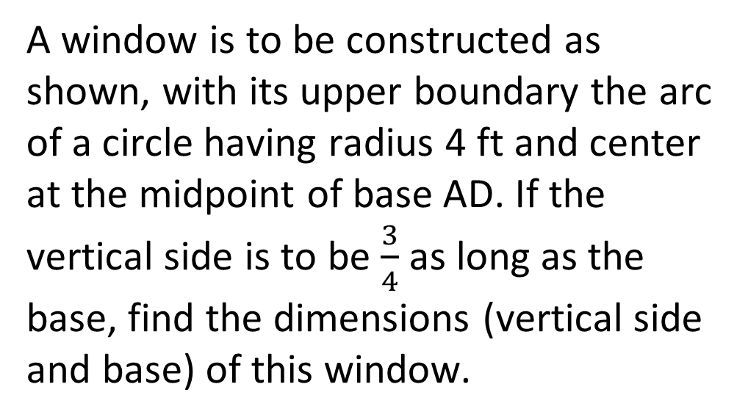
Problems Involving Circles
A window is to be constructed as shown, with its upper boundary the arc of a circle having radius 4 ft and center at the midpoint of base AD. If the vertical side is to be $\frac{3}{4}$ as long as the base, find the dimensions (vertical side and base) of this window.
Notes:
Graphs to Equations:
Start with activity sheets, page 25 of Teaching Guide for SHS: Precalculus
Equations (Standard Form) to Graphs:
https://www.khanacademy.org/math/algebra2/intro-to-conics-alg2/standard-equation-circle-alg2/e/graphing_circles

