Slide 1
HYPOTHESIS TESTING
MAED 602: STATISTICAL METHODS
VON CHRISTOPHER G. CHUA, LPT, MST
Affiliate, ESSU-Graduate School
Notes:
Good morning.
T

Slide 2
Session Objectives
In this fraction of the course on Statistical Methods, graduate students enrolled in the subject are expected to do the following:
Discuss in detail hypothesis testing.
Define important terms related to hypothesis testing (e.i. null and alternative hypotheses, test statistic, critical value and region, type of test, level of significance)
Differentiate Types I and II errors in hypothesis testing.
Describe the steps in hypothesis testing.
Test hypotheses using the traditional method.
This slideshow presentation will be made available through the official course website: mathbychua.weebly.com.
Download the document to use it as reference.

Slide 3
Fundamentals of Hypothesis Testing
Understanding the jargons

Slide 4
Hypothesis
In statistics, a hypothesis is a claim or statement about a property of one or more populations.
Examples of statistical hypotheses:
The average Filipino adult drinks 800 ml of carbonated drinks in a week.
Only ten percent of children who enter Grade 1 will be able to graduate in college.
Hypothesis testing aims to make a statistical conclusion about whether to reject or not reject the hypothesis.
It may or may not be true.

Slide 5
Hypothesis
The best way to determine if a hypothesis was true would be to examine the entire population.
The mean number of text messages received per day by kids aged 15-16 years old in Brgy A is 24.
The mean number of text messages received per day by Filipino teenagers is 24.
Usually impractical
So, examine random samples from the population
If sample data is not consistent with hypothesis, reject it.

Slide 6
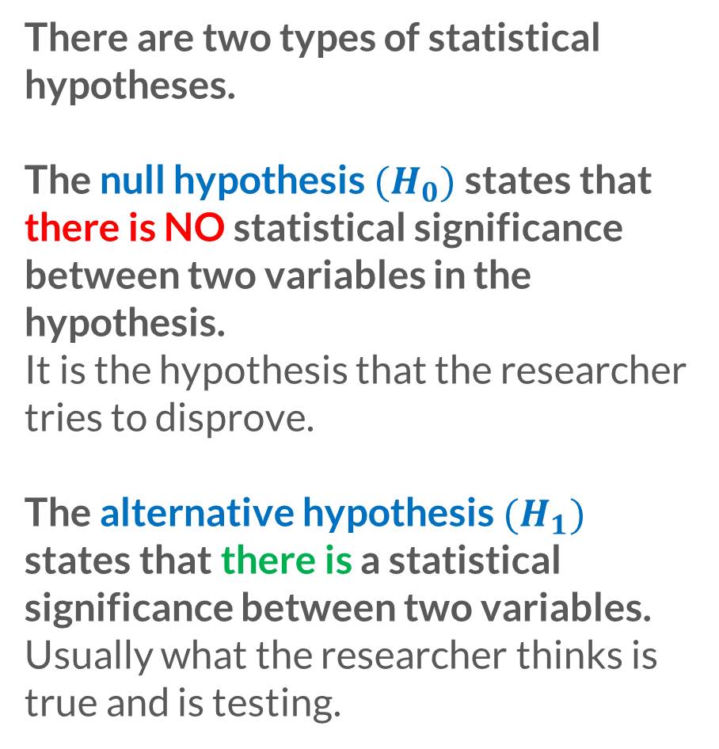
Statistical Hypothesis
There are two types of statistical hypotheses.
The null hypothesis $(H_{0})$ states that there is NO statistical significance between two variables in the hypothesis.
It is the hypothesis that the researcher tries to disprove.
The alternative hypothesis $(H_{1})$ states that there is a statistical significance between two variables.
Usually what the researcher thinks is true and is testing.

Slide 7
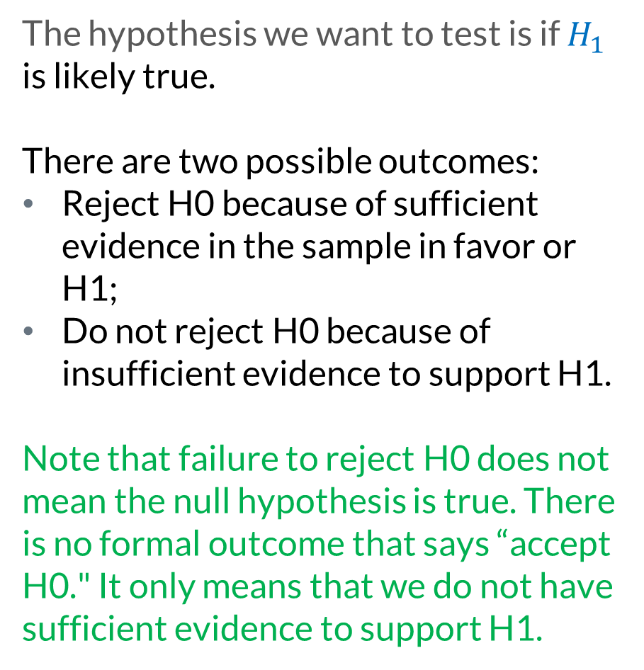
The hypothesis we want to test is if $H_{1}$ is likely true.
There are two possible outcomes:
Reject H0 because of sufficient evidence in the sample in favor or H1;
Do not reject H0 because of insufficient evidence to support H1.
Note that failure to reject H0 does not mean the null hypothesis is true. There is no formal outcome that says “accept H0." It only means that we do not have sufficient evidence to support H1.
Notes:
In a jury trial the hypotheses are:
H0: defendant is innocent;
H1: defendant is guilty.
H0 (innocent) is rejected if H1 (guilty) is supported by
evidence beyond \reasonable doubt." Failure to reject H0
(prove guilty) does not imply innocence, only that the
evidence is insucient to reject it.

Slide 8
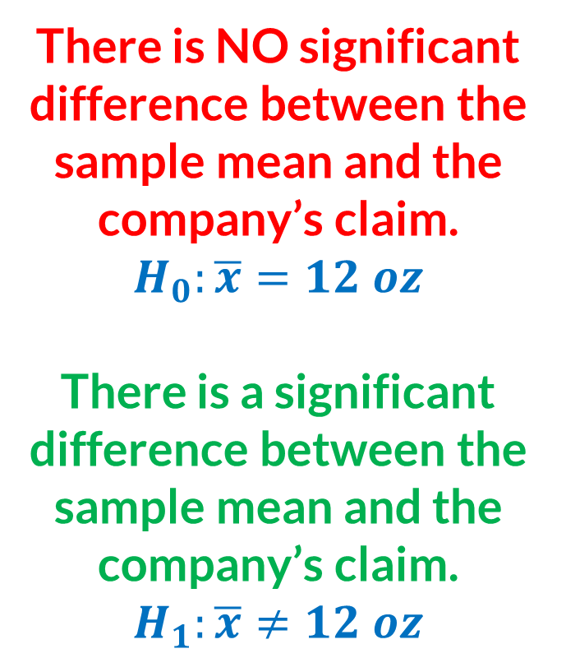
Stating the null and alternative hypotheses
Coca Cola Bottling Company claims that the mean volume of coke in cans is 12 oz. A sample of 200 cans of the soft drink was randomly selected and measured in terms of its liquid volume content. The mean of this sample is 12.38 oz. Is there a significant difference between the sample mean obtained and the company’s claim?
TWO-TAILED HYPOTHESIS TEST
There is NO significant difference between the sample mean and the company’s claim.
$$H_{0}:\overline{x}=12 oz$$
There is a significant difference between the sample mean and the company’s claim.
$$H_{1}:\overline{x}≠12 oz$$

Slide 9
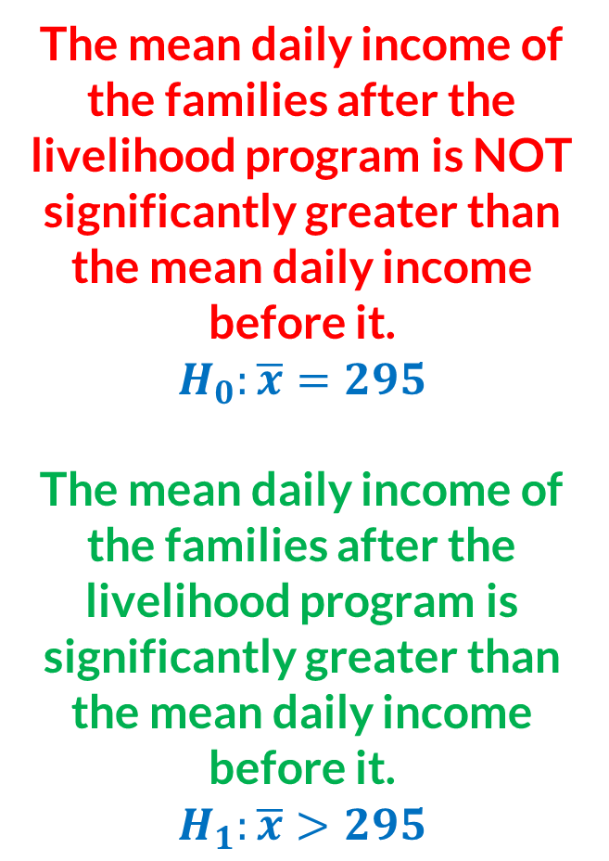
Stating the null and alternative hypotheses
The mean daily income of the families after the livelihood program is NOT significantly greater than the mean daily income before it.
$$H_{0}:\overline{x}=295$$
The mean daily income of the families after the livelihood program is significantly greater than the mean daily income before it.
$$H_{1}:\overline{x}>295$$
The mean daily income of 20 families in Brgy A is 250. An NGO recently conducted a livelihood program for these families. After three months, the mean daily income of these families was recorded at 295 pesos. Is the mean daily income after the livelihood program significantly greater than the mean daily income of the families before it?
ONE-TAILED HYPOTHESIS TEST

Slide 10
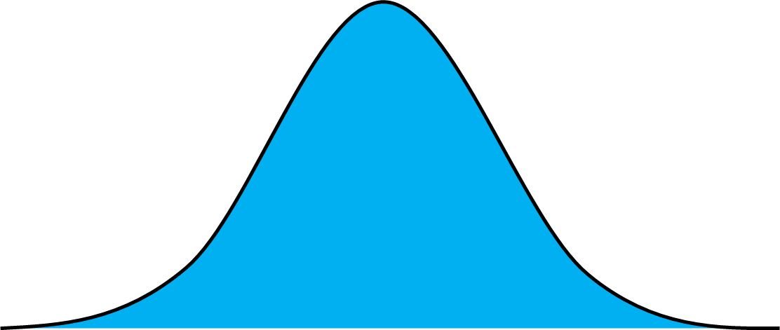


Two-tailed Hypothesis Test
There is NO significant difference between the sample mean and the company’s claim.
$$H_{0}:\overline{x}=12 oz$$
There is a significant difference between the sample mean and the company’s claim.
$$H_{1}:\overline{x}≠12 oz$$
$$\overline{x}=12 oz$$
Non rejection region
Critical / rejection region
$$\overline{x}≠12 oz$$
The critical region is the set of all values of the test statistic that would cause us to reject the null hypothesis.

Slide 11
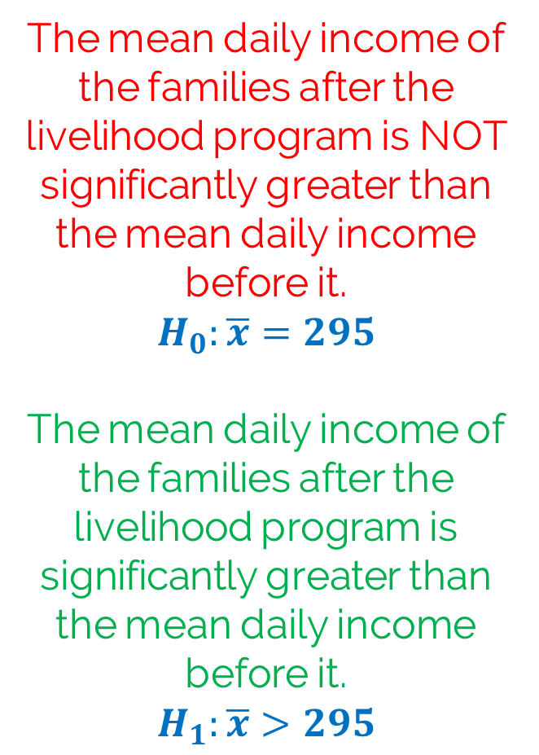


One-tailed Hypothesis Test
The mean daily income of the families after the livelihood program is NOT significantly greater than the mean daily income before it.
$$H_{0}:\overline{x}=295$$
The mean daily income of the families after the livelihood program is significantly greater than the mean daily income before it.
$$H_{1}:\overline{x}>295$$
$$\overline{x}=295$$
Non rejection region
Critical / rejection region
$$\overline{x}>295$$

Slide 12
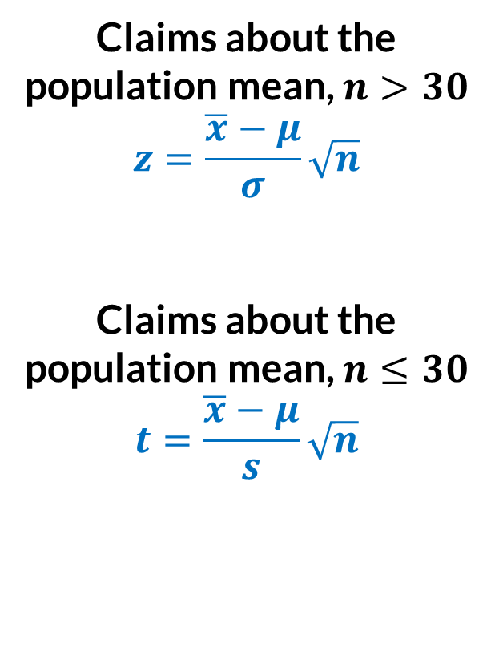
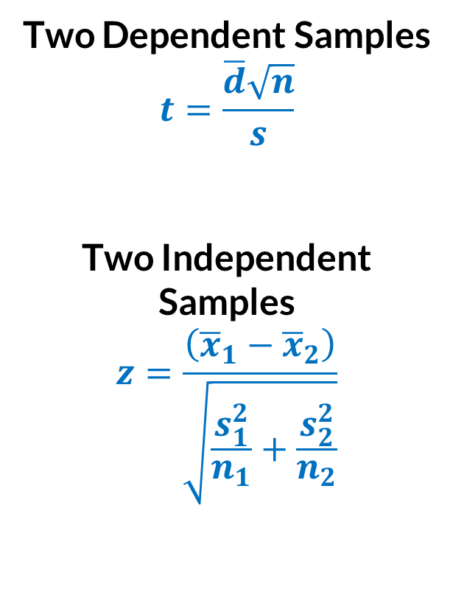
Test Statistic
The test statistic is a sample statistic or a value based on the sample data used in making decision about the rejection of the null hypothesis.
Claims about the population mean, $n>30$
$$z=\frac{\overline{x}−μ}{σ}\sqrt{n}$$
Claims about the population mean, $n≤30$
$$t=\frac{\overline{x}−μ}{s}\sqrt{n}$$
Two Dependent Samples
$$t=\frac{\overline{d}\sqrt{n}}{s}$$
Two Independent Samples
$$z=\frac{\left({\overline{x}}_{1}−{\overline{x}}_{2}\right)}{\sqrt{\frac{s_{1}^{2}}{n_{1}}+\frac{s_{2}^{2}}{n_{2}}}}$$

Slide 13
Types of Errors
 |  | True State of Nature
 |  | The null hypothesis is true. | The null hypothesis is false.
Decision | We decide to reject the null hypothesis. | Type I error (rejecting a true null hypothesis) | Correct Decision
 | We decide not to reject the null hypothesis. | Correct Decision | Type II error (not rejecting a false null hypothesis)

Slide 14





Two-tailed Hypothesis Test
The probability of rejecting the null hypothesis when it is true (Type I error) is called the significance level, denoted by the symbol $α.$This value is typically predetermined.
In two-tailed tests, the level of significance level, $α$ is divided equally between the two tails that constitute the critical region.
Non rejection region
$$0.025$$
Critical / rejection region
$$0.025$$
$$α=0.05$$

Slide 15

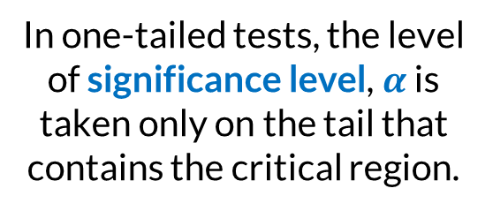
One-tailed Hypothesis Test
One-tailed hypothesis tests can be left tailed or right tailed depending on which tail the critical region is located.
In one-tailed tests, the level of significance level, $α$ is taken only on the tail that contains the critical region.
Non rejection region
Critical / rejection region
$$0.05$$
$$α=0.05$$

Slide 16

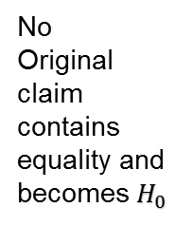



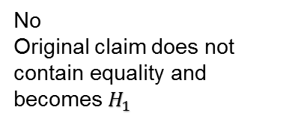


Conclusions in Hypothesis Testing
Start
Does the original claim contain the condition of equality?
Reject $H_{0}$?
“There is sufficient evidence to warrant the rejection of the claim that … (original claim)”
No
Original claim contains equality and becomes $H_{0}$
Yes
(Reject $H_{0}$)
“There is no sufficient evidence to warrant the rejection of the claim that … (original claim)”
No
(Do not reject $H_{0}$)
Reject $H_{0}$?
“The sample data support that … (original claim)”
No
Original claim does not contain equality and becomes $H_{1}$
Yes
(Reject $H_{0}$)
No
(Do not reject $H_{0}$)
“There is no sufficient sample evidence to support the claim that … (original claim)”

Slide 17
Steps in Hypothesis Testing
Going through the process

Slide 18
State the null and alternative hypotheses. Express the hypotheses in symbols.
Determine the appropriate test statistic and the sampling distribution.
Identify or select the significance level and degree of freedom.
Determine the critical values and the critical region and formulate the decision rule.
Compute for the test statistic.
Decide whether to reject or not to reject the null hypothesis. Draw a conclusion.
Traditional Method of Hypothesis Testing
Notes:
A question is important for framing a specific and attainable aim of the lesson, an aim that should be clearly stated in the lesson plan. Starting lesson study without a question would most likely result in beginning a lesson study without a lesson plan.
The beginning question of a lesson study should be connected to the mission of the school and the students’ current state. It must then be broken down into an achievable lesson, one with coherent aims and methods.
Continuity and the desire to improve teaching are critical factors of lesson study that distinguish it from workshops.

Slide 19
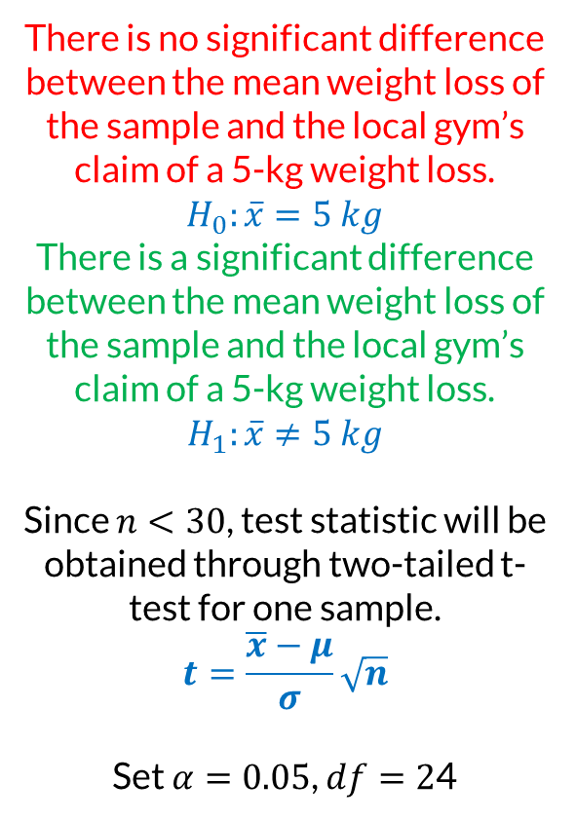
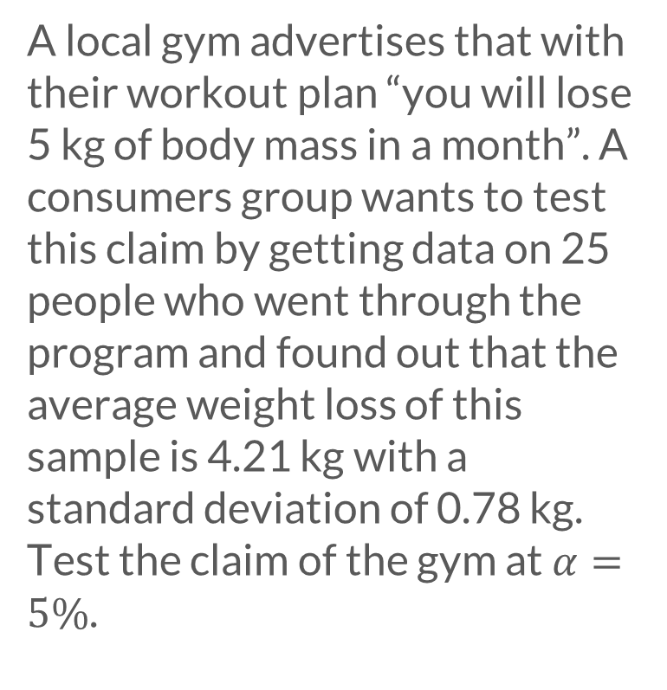
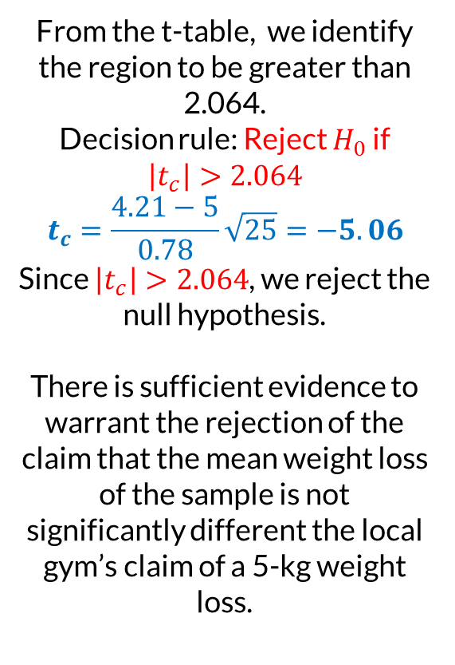
t-test for One Sample
A local gym advertises that with their workout plan “you will lose 5 kg of body mass in a month”. A consumers group wants to test this claim by getting data on 25 people who went through the program and found out that the average weight loss of this sample is 4.21 kg with a standard deviation of 0.78 kg. Test the claim of the gym at $α=5\%$.
There is no significant difference between the mean weight loss of the sample and the local gym’s claim of a 5-kg weight loss. $H_{0}:\overline{x}=5 kg$
There is a significant difference between the mean weight loss of the sample and the local gym’s claim of a 5-kg weight loss. $H_{1}:\overline{x}≠5 kg$
Since $n<30$, test statistic will be obtained through two-tailed t-test for one sample.
$$t=\frac{\overline{x}−μ}{σ}\sqrt{n}$$
Set $α=0.05$, $df=2$4
From the t-table, we identify the region to be greater than 2.064.
Decision rule: Reject $H_{0}$ if
$$\left|t_{c}\right|>2.064$$
$$t_{c}=\frac{4.21−5}{0.78}\sqrt{25}=−5.06$$
Since $\left|t_{c}\right|>2.064$, we reject the null hypothesis.
There is sufficient evidence to warrant the rejection of the claim that the mean weight loss of the sample is not significantly different the local gym’s claim of a 5-kg weight loss.

Slide 20
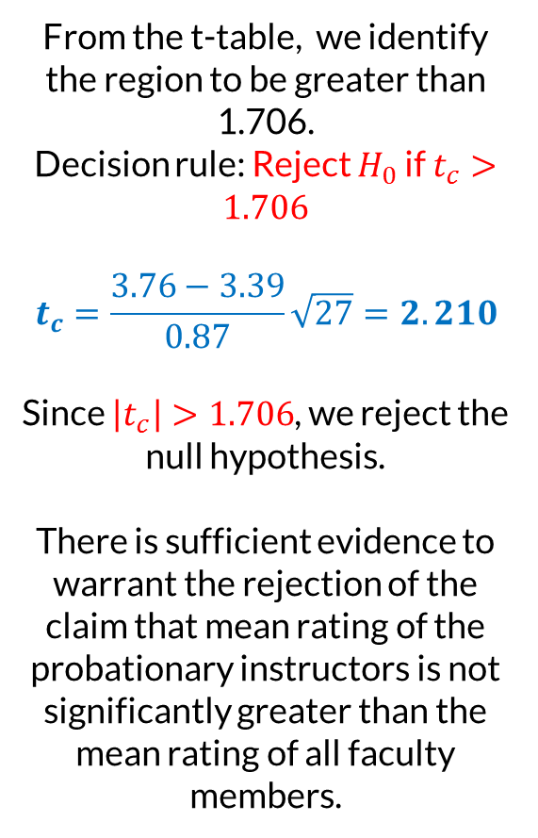
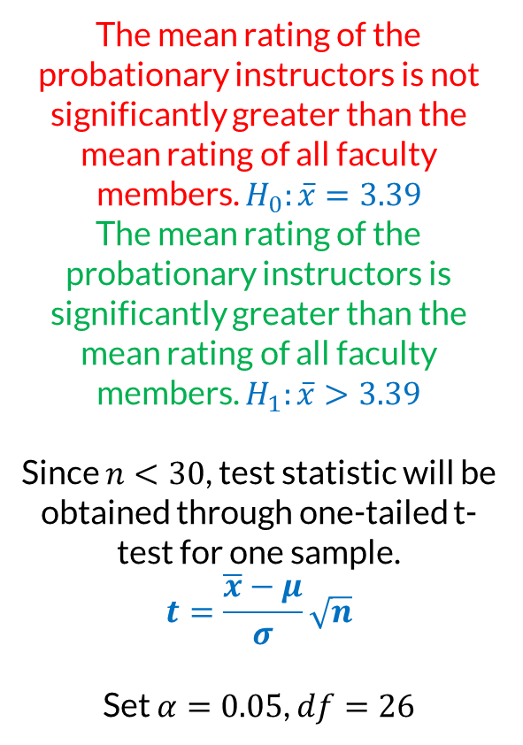
t-test for One Sample
As a means to assess its faculty, the Graduate School of ESSU conducts a faculty evaluation before the end of every term. For the current semester, the average rating of all instructors is 3.39 with a standard deviation of 0.87. On the other hand, twenty-seven newly hired probationary instructors got a mean rating of 3.76. Based from the data, did the probationary instructors get a better rating than the faculty as a whole?
The mean rating of the probationary instructors is not significantly greater than the mean rating of all faculty members. $H_{0}:\overline{x}=3.39$
The mean rating of the probationary instructors is significantly greater than the mean rating of all faculty members. $H_{1}:\overline{x}>3.39$
Since $n<30$, test statistic will be obtained through one-tailed t-test for one sample.
$$t=\frac{\overline{x}−μ}{σ}\sqrt{n}$$
Set $α=0.05$, $df=26$
From the t-table, we identify the region to be greater than 1.706.
Decision rule: Reject $H_{0}$ if $t_{c}>1.706$
$$t_{c}=\frac{3.76−3.39}{0.87}\sqrt{27}=2.210$$
Since $\left|t_{c}\right|>1.706$, we reject the null hypothesis.
There is sufficient evidence to warrant the rejection of the claim that mean rating of the probationary instructors is not significantly greater than the mean rating of all faculty members.

Slide 21
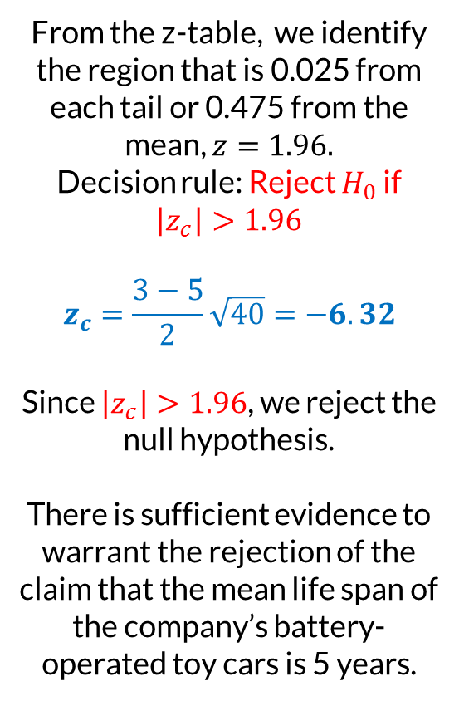
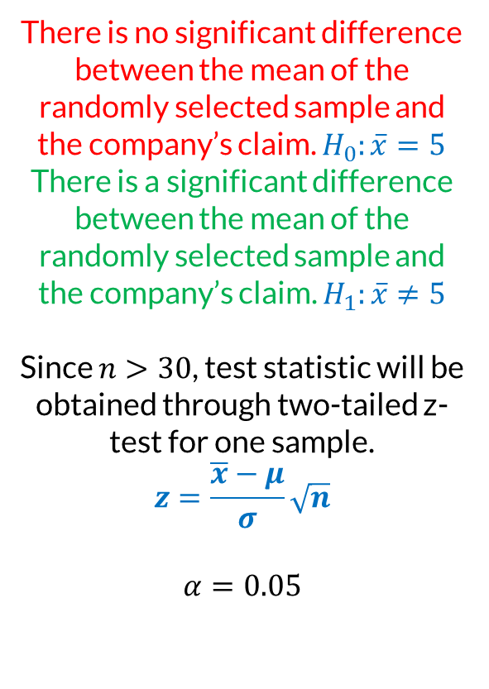
z-test for One Sample
A company which manufactures battery-operated toy cars claims that its products have a mean life span of 5 years with a standard deviation of 2 years. A sample of 40 toys was tested and found to have a mean life span of only 3 years. Using a 5 percent level of significance, determine if there is a significant difference between the mean of the randomly selected sample and the company’s claim.
There is no significant difference between the mean of the randomly selected sample and the company’s claim. $H_{0}:\overline{x}=5$
There is a significant difference between the mean of the randomly selected sample and the company’s claim. $H_{1}:\overline{x}≠5$
Since $n>30$, test statistic will be obtained through two-tailed z-test for one sample.
$$z=\frac{\overline{x}−μ}{σ}\sqrt{n}$$
$$α=0.05$$
From the z-table, we identify the region that is 0.025 from each tail or 0.475 from the mean, $z=1.96.$
Decision rule: Reject $H_{0}$ if $\left|z_{c}\right|>1.96$
$$z_{c}=\frac{3−5}{2}\sqrt{40}=−6.32$$
Since $\left|z_{c}\right|>1.96$, we reject the null hypothesis.
There is sufficient evidence to warrant the rejection of the claim that the mean life span of the company’s battery-operated toy cars is 5 years.

Slide 22
Test concerning two dependent samples
A professor who teaches Algebra offered his students a two-hour lecture on Math anxiety and ways to overcome it. The following table shows the test score in Algebra of seven students before and after they attended the lecture. Test at 2.5% level of significance if attending the lecture helped improve the score in Algebra.
Student | Allan | Bobby | Carlo | Dante | Efren | Frank | Gabby
Before | 56 | 69 | 48 | 74 | 65 | 71 | 58
After | 62 | 73 | 44 | 85 | 71 | 70 | 69
d

Slide 23
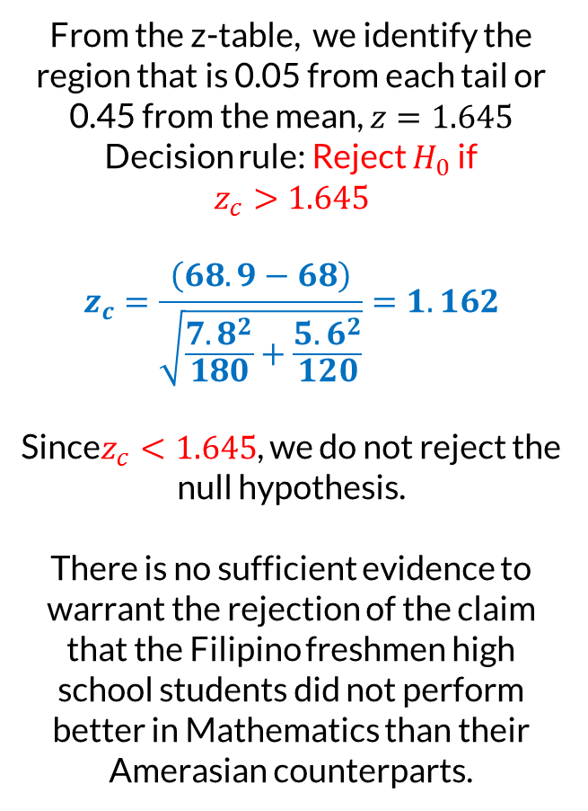
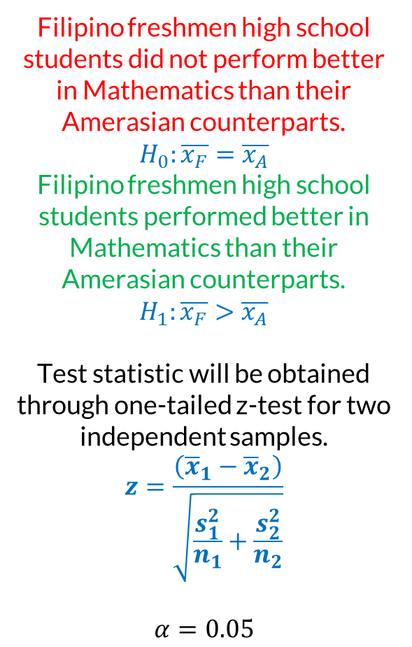
Test concerning two independent samples
A local researcher studied the Mathematics achievement of Amerasians and Filipinos. According to the study, the mean score on a mathematics test given to 120 Amerasian freshmen high school students was 68 with a standard deviation of 5.6. The same test was given to 180 Filipino freshmen high school students and the mean score obtained was 68.9 with a standard deviation of 7.8. Using the 5% level of significance, does the data show that Filipino freshmen high school students performed better in Mathematics than their Amerasian counterparts?
Filipino freshmen high school students did not perform better in Mathematics than their Amerasian counterparts.
$$H_{0}:\overline{x_{F}}=\overline{x_{A}}$$
Filipino freshmen high school students performed better in Mathematics than their Amerasian counterparts. $H_{1}:\overline{x_{F}}>\overline{x_{A}}$
Test statistic will be obtained through one-tailed z-test for two independent samples.
$$z=\frac{\left({\overline{x}}_{1}−{\overline{x}}_{2}\right)}{\sqrt{\frac{s_{1}^{2}}{n_{1}}+\frac{s_{2}^{2}}{n_{2}}}}$$
$$α=0.05$$
From the z-table, we identify the region that is 0.05 from each tail or 0.45 from the mean, $z=1.645$
Decision rule: Reject $H_{0}$ if
$$z_{c}>1.645$$
$$z_{c}=\frac{\left(68.9−68\right)}{\sqrt{\frac{7.8^{2}}{180}+\frac{5.6^{2}}{120}}}=1.162$$
Since$z_{c}<1.645$, we do not reject the null hypothesis.
There is no sufficient evidence to warrant the rejection of the claim that the Filipino freshmen high school students did not perform better in Mathematics than their Amerasian counterparts.

