Slide 2
WRITING CHAPTER 3
UNDERSTANDING DATA
AND WAYS TO SYSTEMATICALLY COLLECT IT

Slide 3
The Learning Goals
Knowing Your Destination. Informing the Journey
choose appropriate quantitative research design
describe sampling procedure and the sample
construct an instrument and establishes its validity and reliability
plan data collection procedure
plan data analysis using statistics and hypothesis testing (if appropriate);

Slide 4
Chapter 3
METHODOLOGY
Research Design
The Sample
The Instrument
Intervention
Data Collection Procedure
Plan for Data Analysis

Slide 5
Research Design
What’s the plan?
Participants are randomly selected. There is an experimental and a controlled group where the experimental group is exposed to treatment.
Quantitative Research Designs
True Experimental Design
Descriptive
Correlational
Experimental
Quasi-Experimental Design
Cross-sectional survey design is done when data is collected at a single point in time.
Used to investigate the direction and magnitude of relationships among variables in a particular population.
Research primarily concerned with cause and effect relationships in studies that involve manipulation and measurement. It utilizes the method of difference.
Participants are not randomly selected.
Pre-Experimental Design
One-group pretest-posttest design provides a comparative description of a group of participants before and after the experimental treatment.

Slide 6
Research Design
Writing this section
This study is quantitative in nature since the research question we seek to answer lead to numerical data.
Specifically, the study is correlational as it aims to determine if there is an association between senior high school students’ use of social media and their attention span in class and assess whether the degree of association between these variables is significant.
Cristobal & Cristobal (2016) defines correlation research as the research design employed to investigate the direction and magnitude of relationships among variables in a particular population.
01
What is the general methodology or research design do you intend to utilize in your proposed study?
02
Why did you choose this research design?
03
What specific type of the research design will you use?
04
Why did you choose this specific methodology?

Slide 7
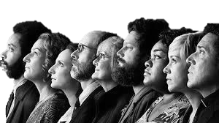
Population and Sample
Sample
A subgroup of the target population that the researcher plans to study for generalizing about the target population.
Getting a fraction to understand the whole
Target Population
A group of individuals with some common defining characteristic that the researcher can identify and study
A more advanced research process is to select individuals or schools who are representative of the population.
Population
a group of individuals who have the same characteristic
Notes:
The first step leading to the process of collecting quantitative data is to identify the people and places you plan to study.
This involves determining which group of people will you study, who, specifically, these people are, and how many of them you will need to involve.
Identifying the representative group that will take part in the study is an important aspect of the research that you need to specify.
Representative refers to the selection of individuals as sample of a population such that the sample are typical of the population under study, enabling you to draw conclusions from the sample about the population as a whole
Computation of n, Slovin’s formula: n=N/(1+Ne^2)

Slide 8
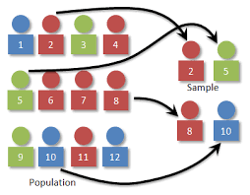
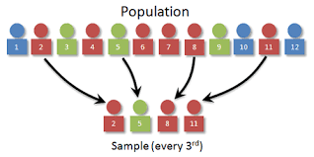
Sampling Techniques
Probability Sampling
SIMPLE RANDOM SAMPLING
SYSTEMATIC SAMPLING
Drawing randomly from a list of the population (e.g.: names from a hat, using a matrix of random numbers).
Taking every kth element in the population as a sample, where
$$k=\frac{N}{n}$$

Slide 9
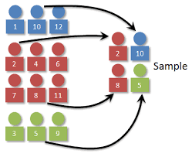
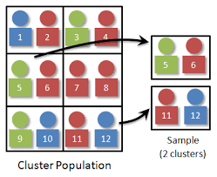
Sampling Techniques
Probability Sampling
STRATIFIED RANDOM SAMPLING
CLUSTER SAMPLING
a process in which certain
subgroups, or strata, are selected for the sample in the same proportion as they exist in the population
The selection of groups, or
clusters, of subjects rather than individuals

Slide 10
Sampling Techniques
Non-Probability Sampling
3
QUOTA SAMPLING
CONVENIENCE SAMPLING
The number of samples is decided by the researcher and selection is also made out of availability of the respondent.
is selecting a group of individuals who are conveniently available
for study

Slide 11
Sampling Techniques
Non-Probability Sampling
PURPOSIVE SAMPLING
SNOWBALL SAMPLING
Using researcher’s judgment to select a sample that they believe, based on prior information, will provide the data they need.
One sample leads on to more of the same kind of sample.

Slide 12
Think of this
A researcher wants to conduct a practical research in order to determine the effectiveness of peer counseling on the decreasing the truancy of his classmates. Of his 56 classmates, he has selected 20 whose residences are within a kilometer’s radius from the school.
What sampling technique did the researcher use?
Do you agree on the strategy he has employed?

Slide 13
The Sample
The target population of the study are the senior high school students during the second term of the academic year, 2017-2018 of De La Salle Araneta University in Malabon City. These students belong to three different strands of the SHS program, namely: Accountancy and Business Management (ABM); Humanities and Social Sciences (HUMSS); Science, Technology, Engineering, and Mathematics (STEM).
With a population size of 500, the researchers will consider a sample of 223 respondents determined using Slovin’s formula for computing sample size with a five percent margin of error. These samples shall be randomly selected through stratified random sampling with the SHS strands being used to define groups and SPSS to randomly determine the samples.

Slide 14
The Instrument
The Key to Finding the Answers
A survey questionnaire is a commonly used type of instrument in research that lists questions about a topic with spaces for responses.
1
This refers to the questionnaire or data gathering tool to be constructed, validated and administered.
2
If researcher-made, it must be tested for validity and reliability.
Yes/No
Do you consider research to be important?
Coding
I use my phone during class.
___ 4 Always
___ 3 Often
___ 2 Seldom
___ 1 Never
Recognition
Which of the following do you consider in buying a phone?
___ brand name
___ price
___ specs
___ others, please specify
3
If adopted, the student should indicate its description as to its items, scoring and qualification.
Subjective
How do you feel when you leave your phone at home accidentally.
4
The researcher must explain its parts, and how the instrument will be validated. The instrument to be used should be appended.
Completion
When I hear my phone ring, I _____________________
TYPES of QUESTIONS

