Slide 1
NORMAL DISTRIBUTIONS
MAED 602: STATISTICAL METHODS
The Normal Curve, Skewness, Kurtosis, and Probability
VON CHRISTOPHER G. CHUA, LPT, MST
Affiliate, ESSU-Graduate School
Notes:
Good morning.
T

Slide 2
Session Objectives
In this fraction of the course on Statistical Methods, graduate students enrolled in the subject are expected to do the following:
Describe normal distributions through the properties of the normal curve.
Convert raw scores into standard (z) scores.
Compute for the area under the normal curve.
Interpret areas under the normal curves as probabilities.
Define skewness and kurtosis.
Describe a distribution in terms of its skewness and kurtosis based on its curve
This slideshow presentation will be made available through the official course website: mathbychua.weebly.com.
Download the document to use it as reference.

Slide 3
Normal Distributions and their Curve
Defining what is normal to know what is not

Slide 4
Consider the following histograms.
Which of these best represents the following distributions:
(1) Height of adult women; (2) monthly income of employees in a company; (3) weight of male college students; (4) number of Facebook friends of teenagers; (5) marrying age of men

Slide 5
This is an example of a normal distribution.
A normal distribution is a continuous probability distribution defined by the probability density function:
$$f\left(x\right)=\frac{1}{σ\sqrt{2π}}e^{−\frac{1}{2}{\left(\frac{x−μ}{σ}\right)}^{2}}$$

Slide 6
Normal distributions are also called the Bell or Gaussian Distribution.
Normal distributions are not represented by just one normal curve but a family of normal curves.
The shape of these normal curves are determined by two important quantities: the mean and the standard deviation.

Slide 7
Defined by the mean and standard deviation
Symmetric around the mean
The three measures of central tendency are equal
Unimodal
The area under the curve is 1.0
Denser in the center, less in the tails
Asymptotic to the x-axis
68% of the area of the normal curve is within one standard deviation of the mean, 95% within 2 sd’s, 99.7% within 3 sd’s (Empirical rule)
Properties of the Normal Curve
Notes:
A question is important for framing a specific and attainable aim of the lesson, an aim that should be clearly stated in the lesson plan. Starting lesson study without a question would most likely result in beginning a lesson study without a lesson plan.
The beginning question of a lesson study should be connected to the mission of the school and the students’ current state. It must then be broken down into an achievable lesson, one with coherent aims and methods.
Continuity and the desire to improve teaching are critical factors of lesson study that distinguish it from workshops.

Slide 8
Symmetric around the mean
The three measures of central tendency are equal
Unimodal
Denser in the center, less in the tails
Normal Distribution
Bimodal Distribution
Positively-skewed Distribution
(Skewed to the right)
Negatively-skewed Distribution
(Skewed to the left)

Slide 9
Standard Score and Area Under the Normal Curve
How far do you mean? What are my chances?

Slide 10
The mean score of 250 job applicants of a private company in an English Proficiency Test is 67 with a standard deviation of 6. If this data is normally distributed, what interval would represent scores within one standard deviation away from the mean? 2 standard deviations? 3?
$$1sd=6$$
$$−3sd$$
$$−2sd$$
$$−1sd$$
$$\overline{x}=67$$
$$+1sd$$
$$+2sd$$
$$+3sd$$

Slide 11
Jason was one of the applicants. He was told that he got a score of 79 in the test. What percent of the applicants did Jason outrank in the test with his score?
Kaye also took the test and obtained a score of 75. What percent of the applicants did she outrank in the test?
$$1sd=6$$
$$−3sd$$
$$−2sd$$
$$−1sd$$
$$\overline{x}=67$$
$$+1sd$$
$$+2sd$$
$$+3sd$$

Slide 12
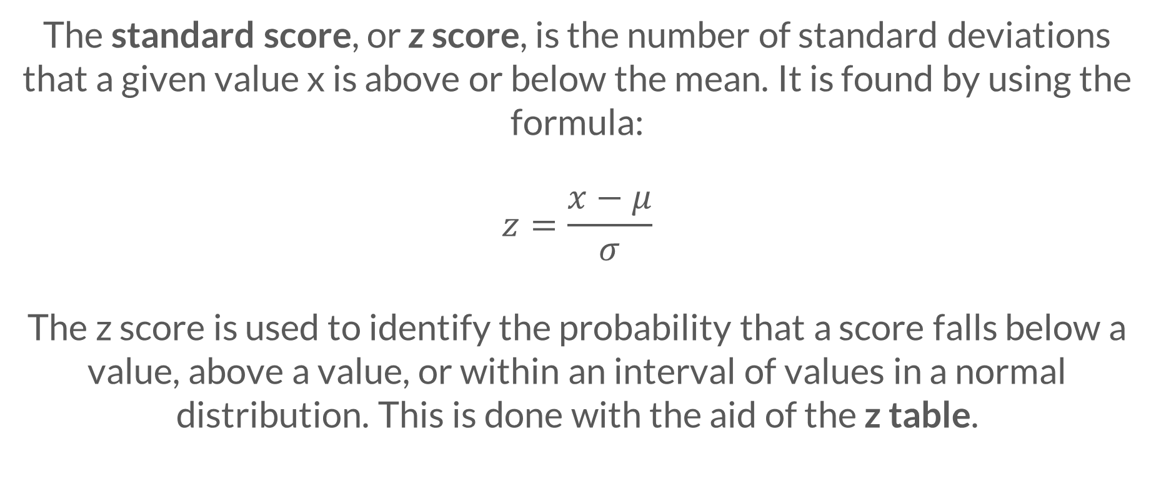
The standard score, or z score, is the number of standard deviations that a given value x is above or below the mean. It is found by using the formula:
$$z=\frac{x−μ}{σ}$$
The z score is used to identify the probability that a score falls below a value, above a value, or within an interval of values in a normal distribution. This is done with the aid of the z table.

Slide 13
$$1sd=6$$
$$−3sd$$
$$−2sd$$
$$−1sd$$
$$\overline{x}=67$$
$$+1sd$$
$$+2sd$$
$$+3sd$$
What is the probability that an applicant got a score of 70 or less? greater than 60? at least 80?
What is the probability that an applicant got a score between 58 and 69?

Slide 14
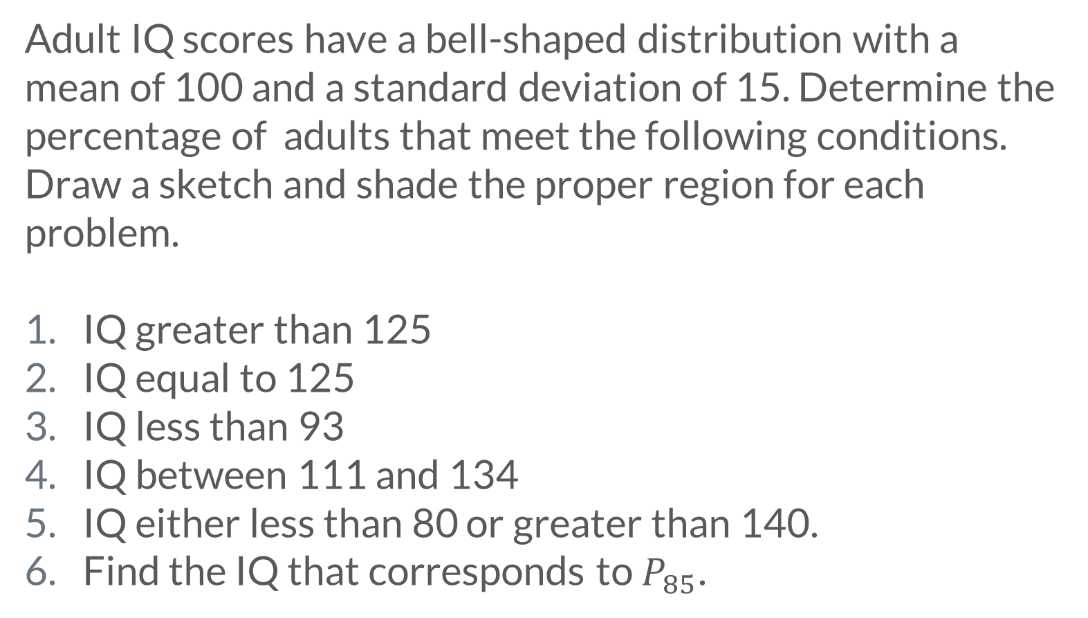
Adult IQ scores have a bell-shaped distribution with a mean of 100 and a standard deviation of 15. Determine the percentage of adults that meet the following conditions. Draw a sketch and shade the proper region for each problem.
IQ greater than 125
IQ equal to 125
IQ less than 93
IQ between 111 and 134
IQ either less than 80 or greater than 140.
Find the IQ that corresponds to $P_{85}$.

